Slide 1
Immersive Rigging and Skinning in Virtual Reality Environments

Slide 2
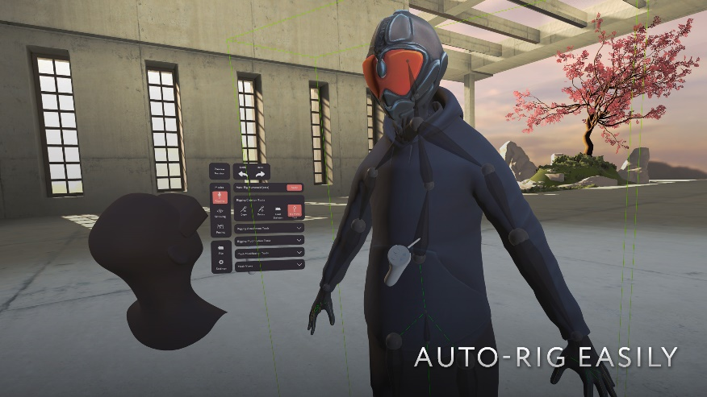
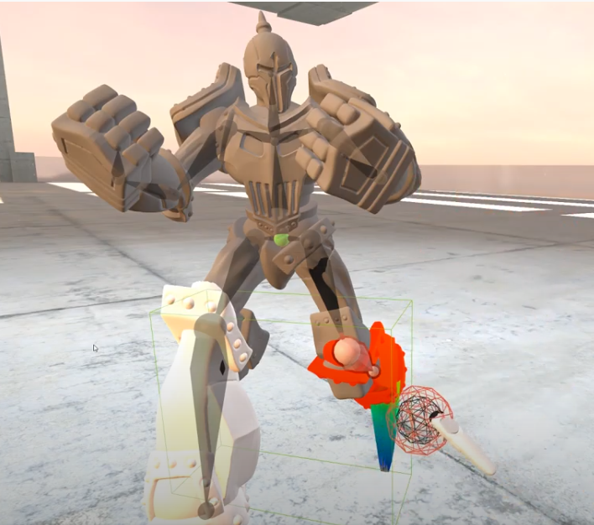
Related works (Immersive rigging)
MasterpieceVR https://www.youtube.com/watch?v=NcByctd_PNg
Pro:
Mirroring bones
Intuitive skinning tool
Cons:
Switch between diff. Skeleton types. (BVH, )
Define Dofs for each bone.
Apply user‘s motion to the model.

Slide 3
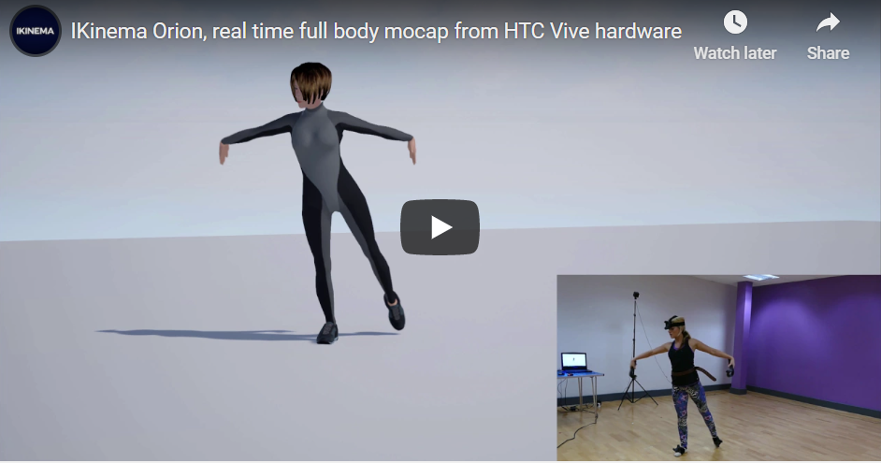
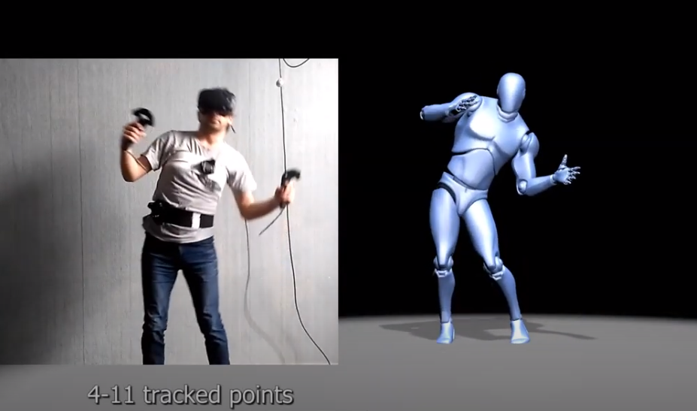
Related works (motion capturing with IK)
Ikinema
https://www.youtube.com/watch?v=Khoer5DpQkE
VR Mocap Studio
https://www.youtube.com/watch?v=QUsJbcyeRUI
Pro:
Low cost, user friendly (gamers).
No need for specific calibration (Ikinema, not the other).
Cons:
Dof adjestments may not supported
Custom skeletons may not supported
At least 4 trackers
Artifacts

Slide 4
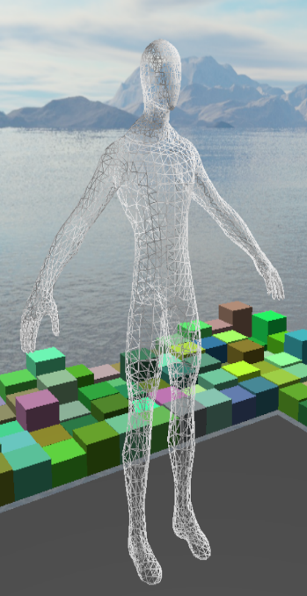
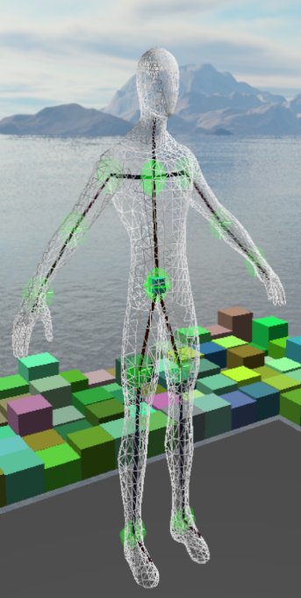
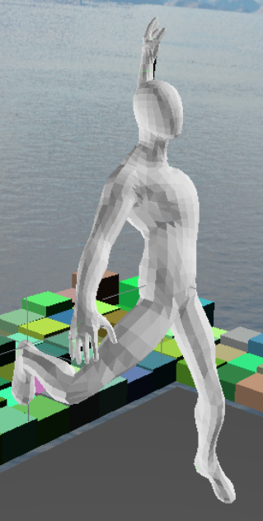
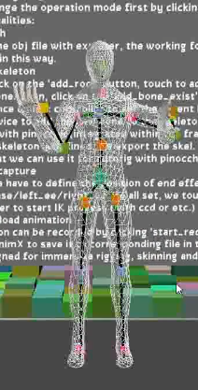
goal
Simple and extensible framework for Rigging, Skinning, Animation and Motion Capturing
Flexible and „idea ready“.
Mocap/
Rigging
Animation
Skinning
Refine
The workflow

Slide 5
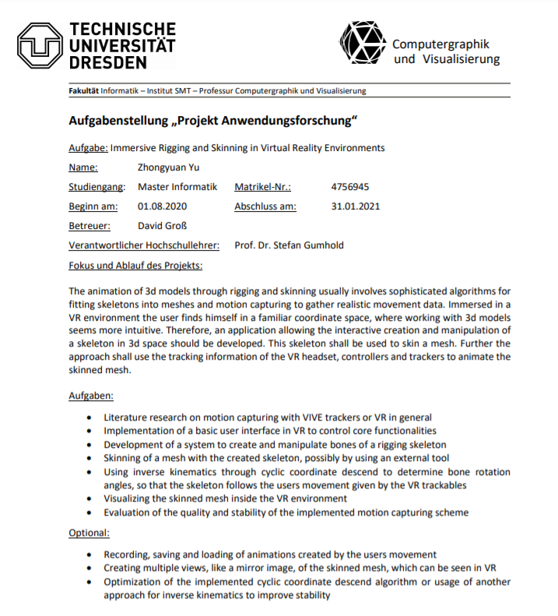
Tasks
Basic user interface
Create and manipulate bones for a given mesh [Rigging]
Skinning of a mesh with the created skeleton [Skinning]
Visualizing the skinned mesh
Record users movement
Recording, saving animations [Animation]
Creating multiple views
Evaluation of the quality of the mocap [Mocap]
Optimization of the IK algorithm

Slide 6
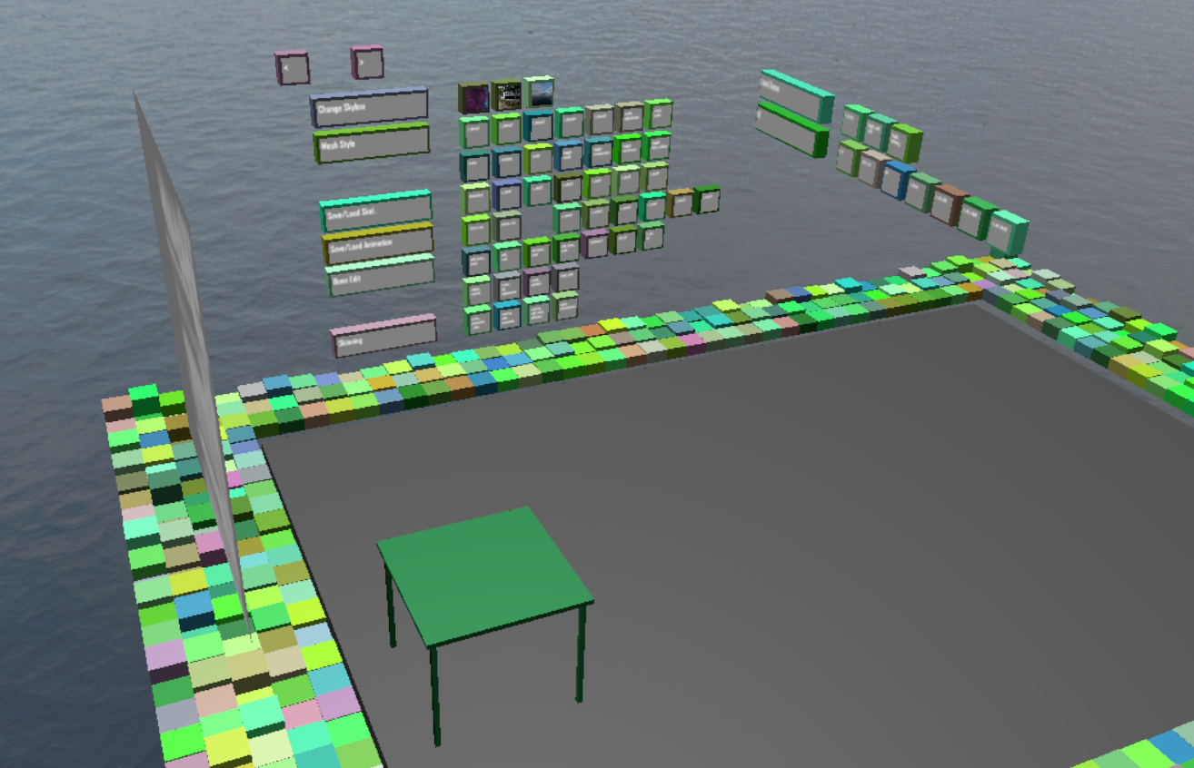
Basic user interface
1) The „BoxGui“
flexible and extensible:
A simple solution for interaction. Almost all kinds of widgets are supported. Buttons can easily be managed into groups.
There is a “boxgui_button” class to manage the properties of the buttons. In a header file called “BoxGui.h”.
Visual feedback
provided when intersection happens.
But
can only support a few words on each button, which makes a little bit hard for users to know the functionalities.
Buttons are arranged on a virtual wall. They are assigned to random colors.

Slide 7
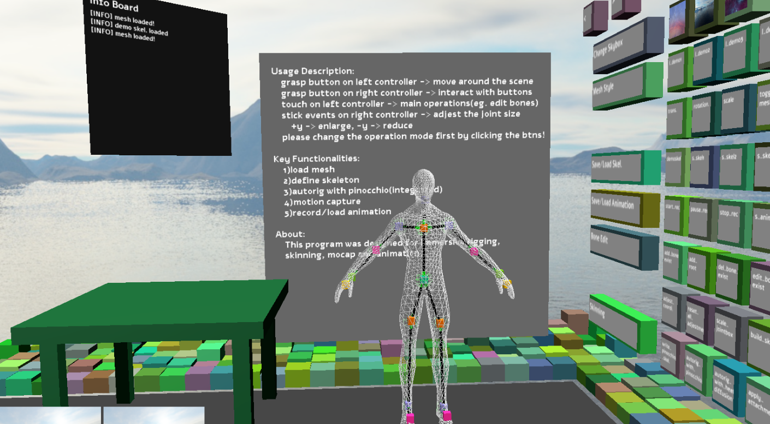
Create and manipulate bones for a given mesh
2.1) Render A Given Mesh
A custom mesh renderer:
It contains a vertex shader, a geometry shader, a fragment shader, and some c++ codes to upload/ update data. E.g. bone attachment matrices, model view matrix and some Boolean variables. The mesh can thus be adjusted according to bone movement.
Different rendering modes possible:
One can render the given mesh in one of the following modes: transparent mode, wireframe mode and with back face culling.
The view from the initial pose, and the mesh is rendered in wireframe mode.

Slide 8
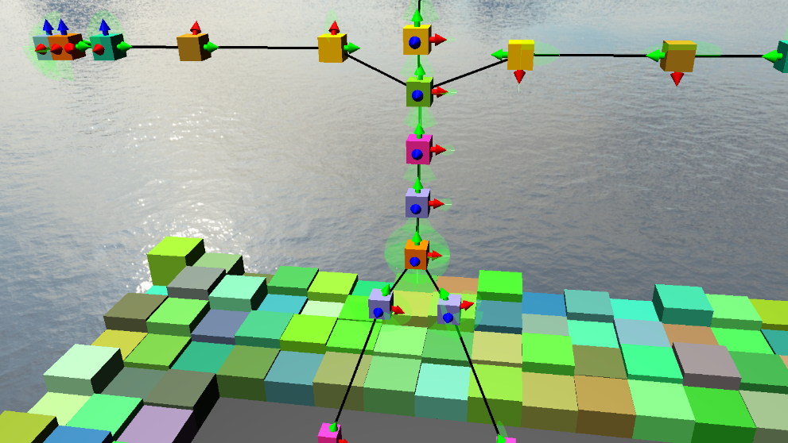
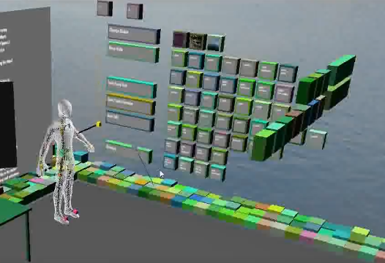
Create and manipulate bones for a given mesh
2.2) Modifications to An Existing Skeleton
Iteratively:
A load of a predefined skeleton from disk is supported. That means one can continually refine a skeleton in a simple way.
Flexible:
It is quite flexible that skeletons can be defined for a given mesh in any shape.
Currently supported operations:
One can add, delete and move the selected bone.

Slide 9
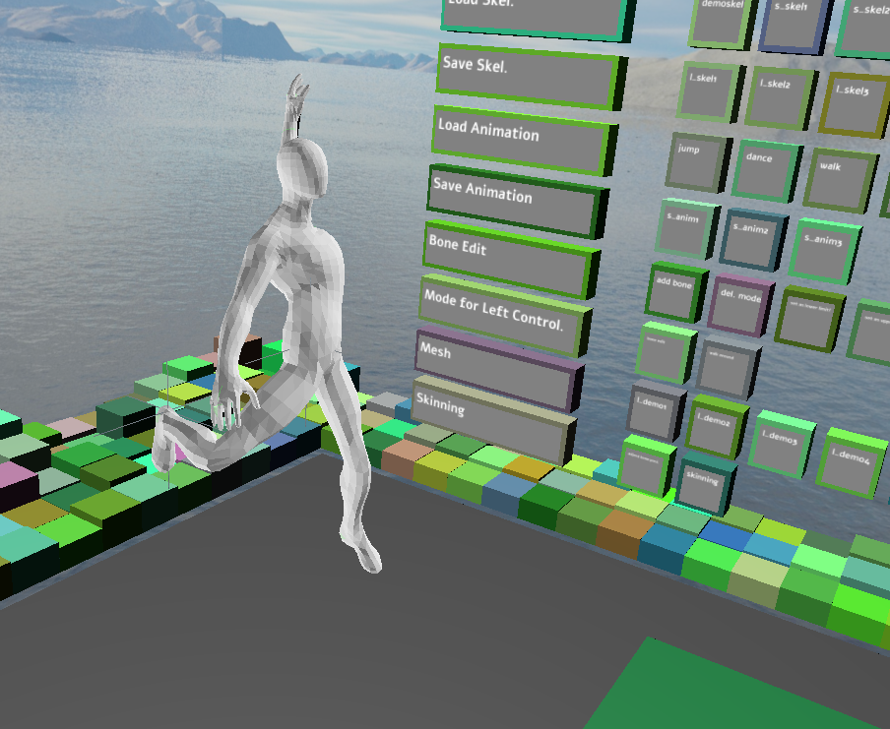
Skinning of a mesh with the created skeleton
3) Skinning With Pinocchio Library
Generate skel:
When rigging is finished, a skeleton is defined and transformed to a special format which can be feed into Pinocchio.
Load skel:
The attachment data for bones is available as output file. We have to load it explicitly in the VR scene, by clicking the button.
Alternative:
As the skeleton is defined according to the given mesh directly, we can assume that it will fit the mesh well. Thus a custom skinning tool may be a better choice.
The given mesh can be adjusted according to the skeleton. Which provides an animation effect. Here we take the spiderman as an example.

Slide 10
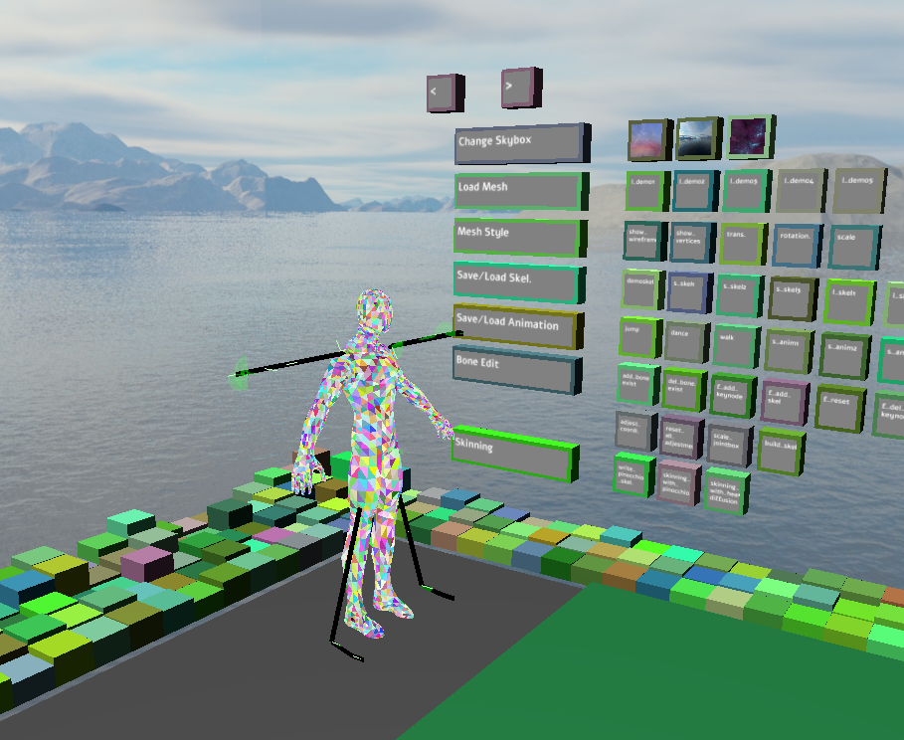
Visualizing the skinned mesh
4) Visualizing The Skinned Mesh
Method1:
We can visualize a skinned mesh by varying the position/ direction of individual bones.
Method2:
Or different color can be used to render individual bones depends on the value it takes. (bone weights)
The skinned mesh can be visualized in more than those two ways.

Slide 11
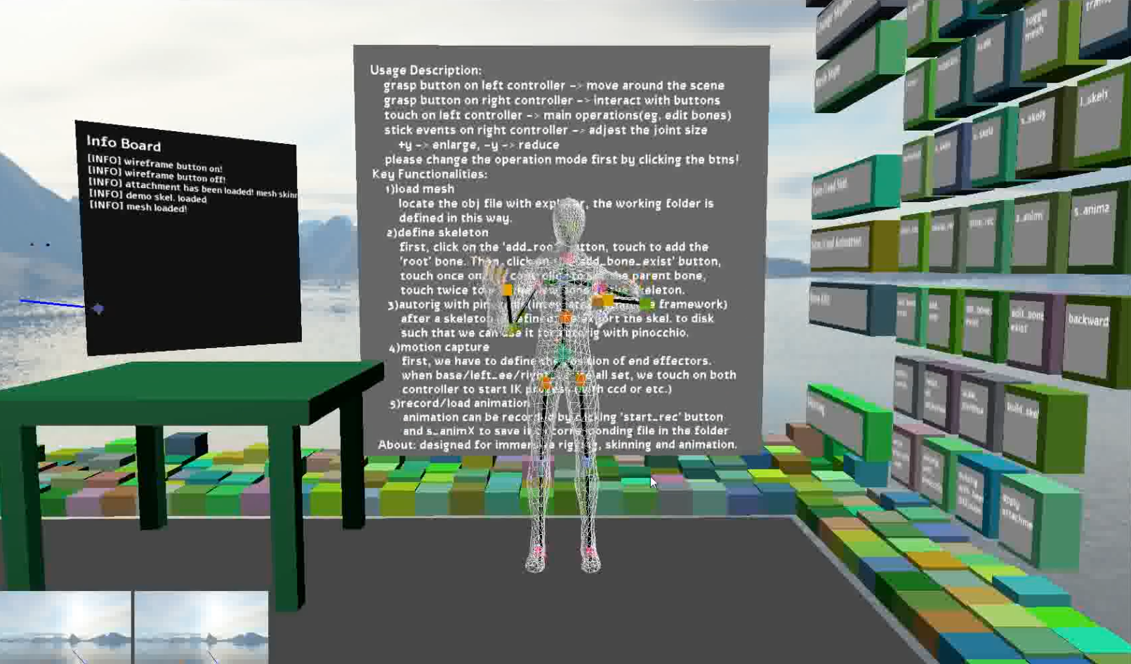
Record users movement with ik
5) Record Users Movement with IK
capture the user movements in VR
we can use the positions of the controllers as well as the position of the headset. (Or other trackables) The other parts of the skeleton of the character can be adjusted accordingly with help of IK algorithm.
We may not get an accurate result,
But an acceptable result of the motion can be captured without special equipments.
Which is suitable for the case of VR games and some other similar applications.
A acceptable result can be acquired with minimal effort.

Slide 12
Record users movement with ik
5) Record Users Movement with IK
Support IK algorithm with multiple targets:
calculate IK chains multiple times with different target positions.
Other IK algorithms can be easily involved.
CCD can not handle multiple end effectors when there are conflicts along kinematic chains.
I chose thorax to be the base bone when controlling with two controllers and hmd. Thus, no conflicts.
When more trackers involved, FABRIK algorithm has to be used.

Slide 13
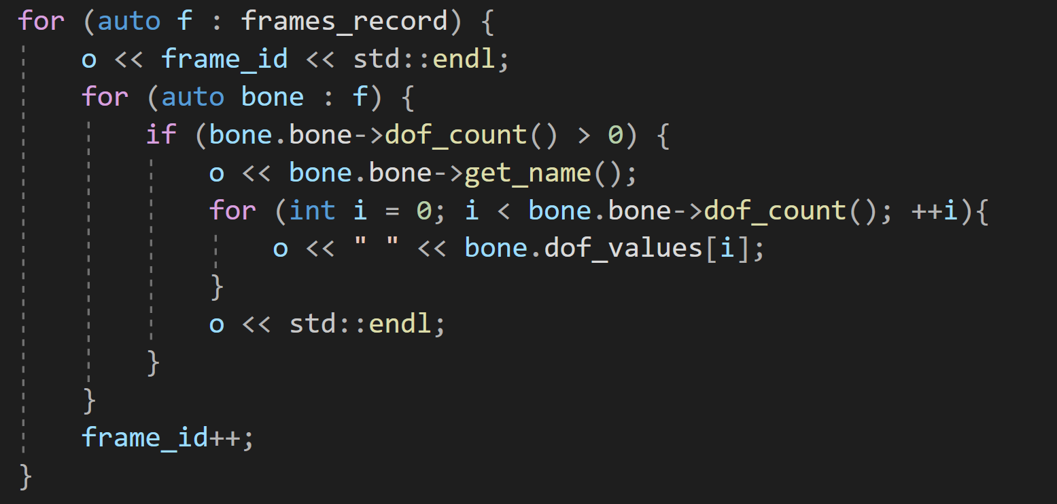
Recording, saving animations
6) Recording, Saving Animations
On GUI:
Animations can be loaded and played with help of Gui buttons in the scene.
Implementation Detail:
Animation can be recorded frame by frame. Each frame contains a list of bone dofs.
Feature1:
The currently implemented animation assumes that the local frame is aligned to the world frame. Further work will support the other cases.
Feature2:
Adjestable framerate. Which is 60Hz now. The Output is a file with .anim extension.

Slide 14
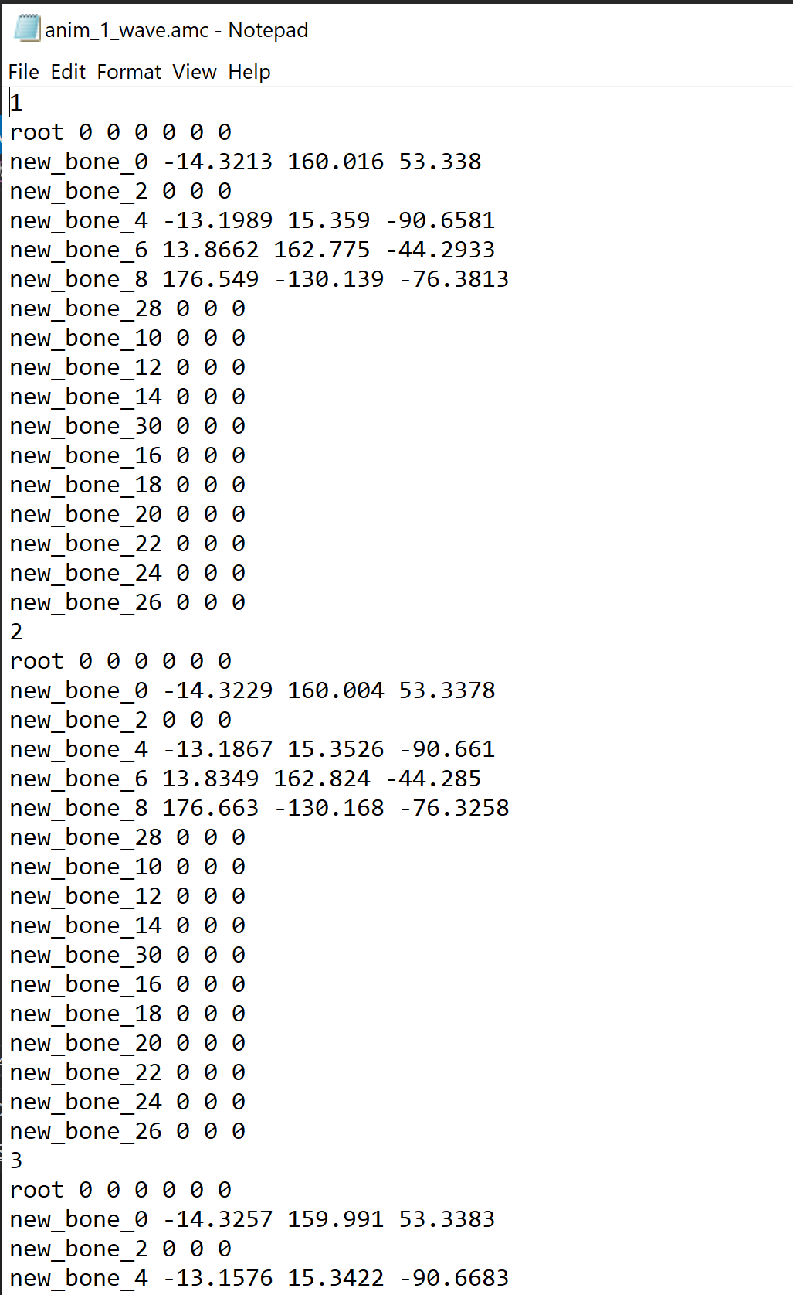
6) Recording, Saving Animations
Implementation Detail:
Animation can be recorded frame by frame. Each frame contains a list of all bone dofs.

Slide 15
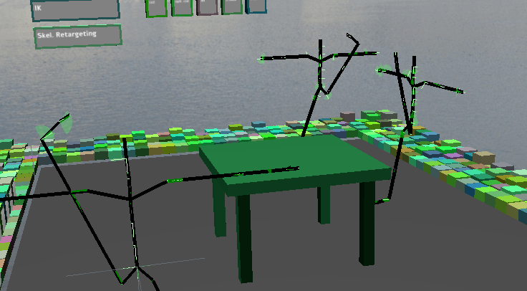
Creating multiple views
7) Creating Multiple Views
To support mirror effect, multiple skeletons are imported to the scene. As can be seen on right side.
One main skeleton can be controlled by user and the other two imitates it.
As for detail, just iterate all bones of the other two skeleton and assign the dofs the same as the one we want to initate.
Multiple skeletons

Slide 16
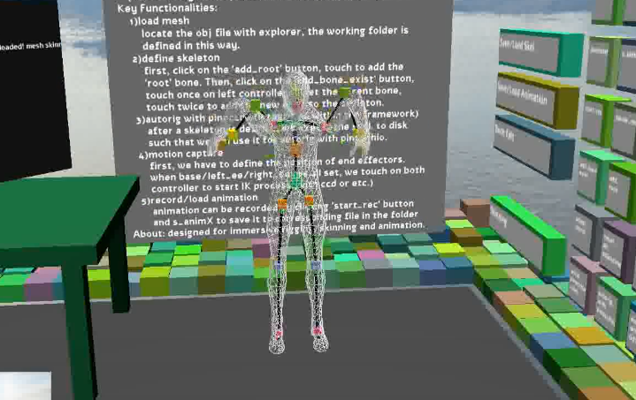
Evaluation of the stability of the mocap (Future work)
8) The Mocap may be unstable now
Orientation information is not used. Only positions are fed to IK, where the orientation of end effectors should also be used. (otherwise, body will be twisted easily)
Such a motion capture scheme does not guarantee an accurate result. IK problems may be ill-posed. (no solution in range or many solutions exist)
The dofs of the bones are not adjusted yet, the result may looks unnatural now.
Solution: allow users to adjest dofs in the application. And solve constrained IK.
IK based Mocap

Slide 17
summary
Rigging, Skinning, Animation and Motion Capturing are ported to vr as a pipeline.
Flexible and „idea ready“ framework.
Mocap/
Rigging
Animation
Skinning
Refine

